Slide 1
2nd Briefing : Industrial Training Semester 2 2022-2023 20 October 2022

Slide 2
Content
Industrial Training Calendar
Pre-requisite
Internship Placement Application
FYP
Logistics Issues
Workshop
Contact Us

Slide 3
Industrial training Calendar
Three (3) phases:
Organization Selection and Allocation.
Training and Evaluations.
Documentation and Grading.

Slide 4
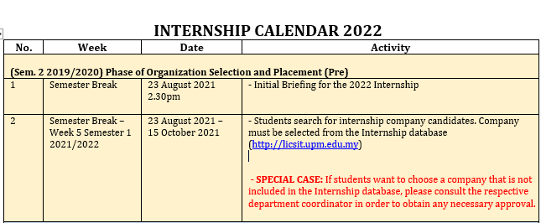
The 2023 Internship Calendar
Students can check the important date through the LI System
(Menu – Documents – Industry Training Calendar)

Slide 5
Industrial Training Calendar

Slide 6
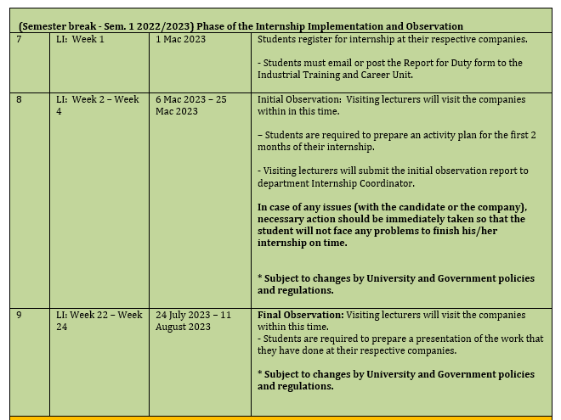
Industrial Training Calendar

Slide 7
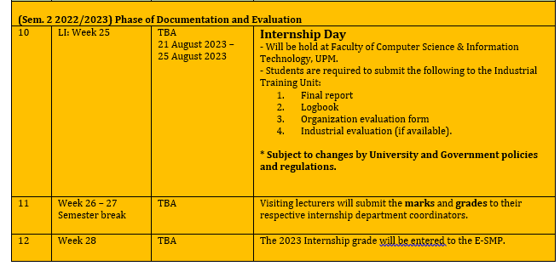
Industrial Training Calendar

Slide 8
Prerequisite
To enroll for LI 2023 (SKM/SKR/SSK/SSE 4901), students should have fulfilled their prerequisite courses based on department:
Multimedia: Prerequisite = SKM3300, or with the approval of the Department.
Network: Prerequisite = SKR3504 or with the approval of the Department.
Computer Systems: Prerequisite = SSE3001 and SSK3408, or with the approval of the Department.
SE/IS: Prerequisite = SSE4300 and with the approval of the Department.
Students are not allowed to enrol in other subjects while doing the LI 2023

Slide 9
How to Apply for LI?
List of companies/organizations in the database
Please visit http://licsit.upm.edu.my/
Username : UPM ID
Password : UPM ID PASSWORD
Students are advised to regularly check the announcement in the LI System since the LI Unit might post vacancies from companies not in the database.
Students are expected to do their due diligence (research) on the chosen companies/organizations, particularly the following matters:
Job scope (must be related to computer science / ICT)
Special note for Multimedia students… Design/creative works should not be the main task during your LI 2022.
Allowances
Transportation to and from the work place
Costs (including accommodation, transportation, food etc.)
Safety
Please choose your companies/organizations carefully.

Slide 10
How to Apply for LI?
Enter the LI System - http://licsit.upm.edu.my/
Update information in basic profile
Fill in resume
Upload the result semester
shortlist THREE potential companies/organizations
Send the application to the 3 potential companies/organizations.
The system will send the resume, result semester and application letter to the chosen company
For application through company website/portal/job street/etc, students need to make their own application.
Follow up the chosen company
Student need to update placement in the LI System after accept the offering. Once you accept the offer, the other applications will be automaticaly cancelled.
Student need to make a new application if there is any UNSUCCESSFUL applications

Slide 11
Final Year Project
Student with ‘F’ grade in FYP will not be allowed to register for LI.

Slide 12
Logistics Issues
Please ensure all logistic issues as the followings have been taken care before you start your LI.
Location
Housing
Transportation/ journey to work place.
Cost of living
Allowances
Safety
University will not provides all the above matters.
Students are responsible for all the above matters.

Slide 13
Workshop
Here is the plan of activities that will be held this year.
Date : 27/11/2022 I Sesi Jom Bersama Yayasan Peneraju (Bumiputera)
Date : 10/11/2022 I Experience Sharing Session by Alumni
Date : 28/11/2022 I Pitching Day (Introduction to the company)

Slide 14
Reminder
LI department coordinator need to be updated on your LI application status.
Final briefing will be held in Week 12, Semester 1 2022/2023
We target by Week 12, all students should have their placement for internship.
Once the company offer the internship, the students have 1 weeks to accept the offer. Once accepted, no changes can be done.
Please contact your LI Department Coordinator if you have any problems.

Slide 15
Lessons to learn
Not serious and last minute search for companies – resulted inappropriate company.
Looking for higher allowance rather than more potential learning experiences.
Reject offer from 1st company and expecting other company and finally none company to choose.
Not much support from UPM for oversea company, only flight ticket and small amount of allowances.
12 credits = 4 subjects with 3+0 credit

Slide 16
CONTACT US
Contact us :
Dr. Salfarina Abdullah (012-3632118) – Head of Unit LI
Dr. Nor Azura Husin (011-12819303) –JSK Coordinator
Dr. Alfian Abdul Halin (012-5579140) – JMM Coordinator
Dr Ts Mohd Hafeez Osman (019-2544787) - JKPSM Coordinator
Mr. Ahmad Alauddin (019-3173774) - JTKR Coordinator
Admin. assist, Pn Norbaayah, 013-3519054

Slide 17
Q & A

